Slide 1
Location, Location, Location!
By Daren

Slide 2
Problem Statement
LLL Properties have been claiming that location is the second-most important predictor of home value after property size
Prove or disprove the accuracy of their predictive model, and come up with a more accurate model if possible
Notes:
Audience is LLL Properties business executives

Slide 3
Methodology
Conduct external research to identify common predictors of home value
Select those features from data set and use lasso regression to discover the features with the best predictive power
Plot 5 types of regression for each of:
LLL’s model
‘Quality’ mode
Optimal model
Prove or disprove LLL’s belief in location being a significant predictor of home value
Notes:
Read articles on real estate websites about predictors for home value
Regression types: linear, polynomial, ridge, lasso, elastic net

Slide 4
Location
MS Zoning
Neighborhood
Condition 1
Condition 2
Structural Construction Materials and Updates
Overall Qual
Age of the Home
Year Built
Design Style of the Home
MS SubClass
House Style
Curb Appeal
Lot Frontage
Lot Config
Number of Bedrooms
Bedroom Abvgr
Number of Bathrooms
Bsmt Full Bath
`Bsmt Half Bath
Full Bath
Half Bath
Square Footage
Low Qual Fin SF
Total Bsmt SF
Lot Area
Gr Liv Area
Heat and Air
Central Air
Heating
Utilities
Garage Space
Garage Area
Recent Home Renovations
Year Remod/Add
Overall Cond
Comps
Bldg Type
Pool QC
Features

Slide 5
EDA
Heatmap
Feature selection through lasso regression

Slide 6
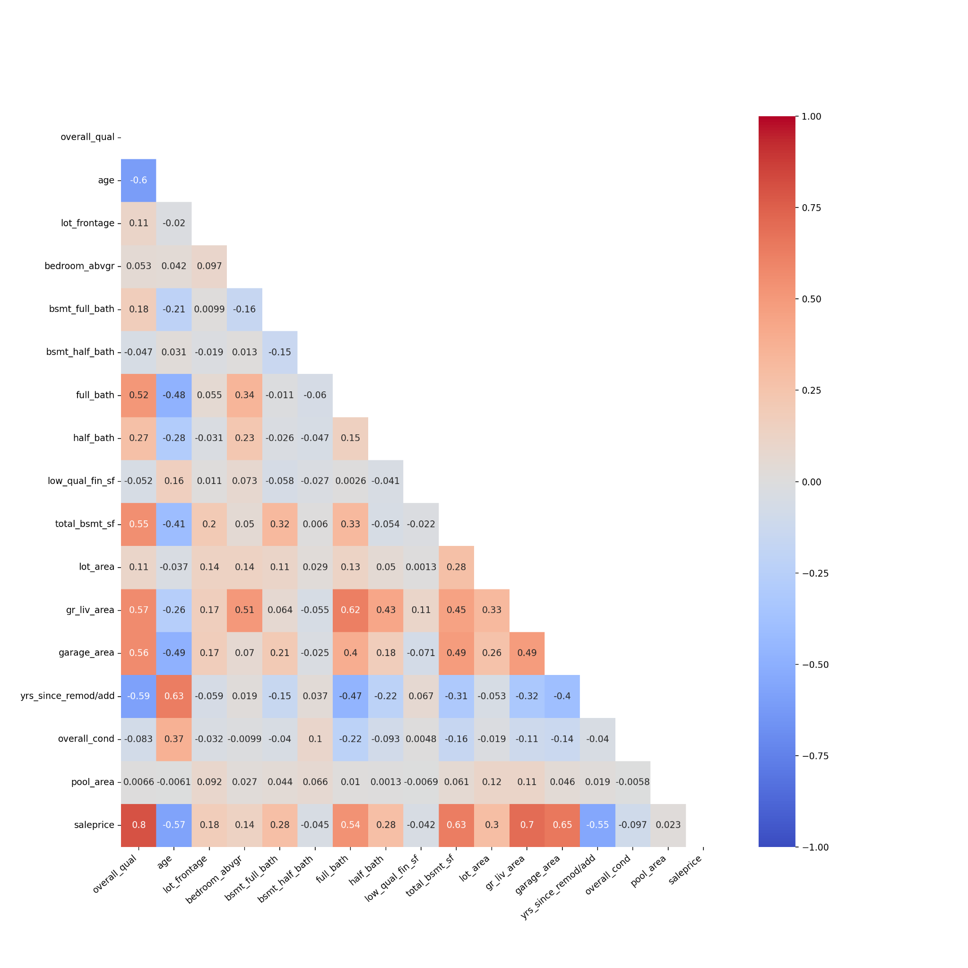
Heatmap
Notes:
Overall quality, full bath, half bath, total basement size, above grade area, garage; strong positive predictors
Years since remodelling, age: strong negative predictors
Important to note that the heatmap only shows correlation between the individual feature and the sale price
Not representative of lasso regression
Things to do better next time: heatmap with all of the features to better identify relationships between them

Slide 7
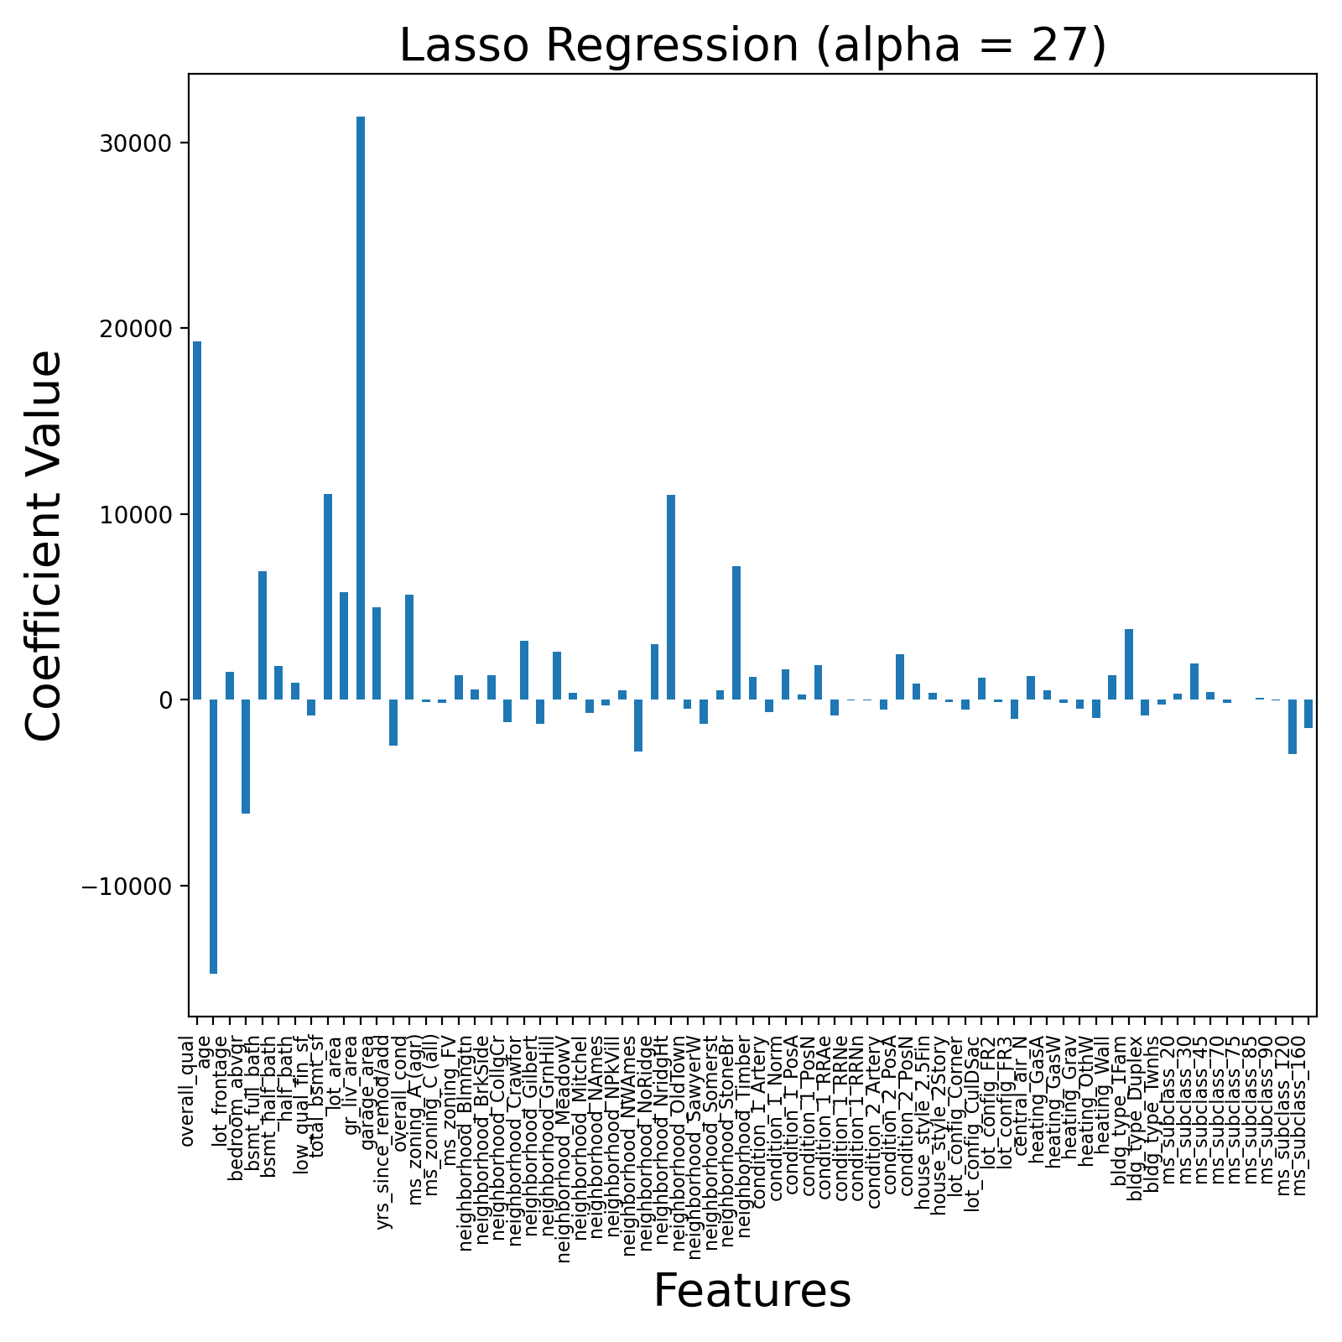
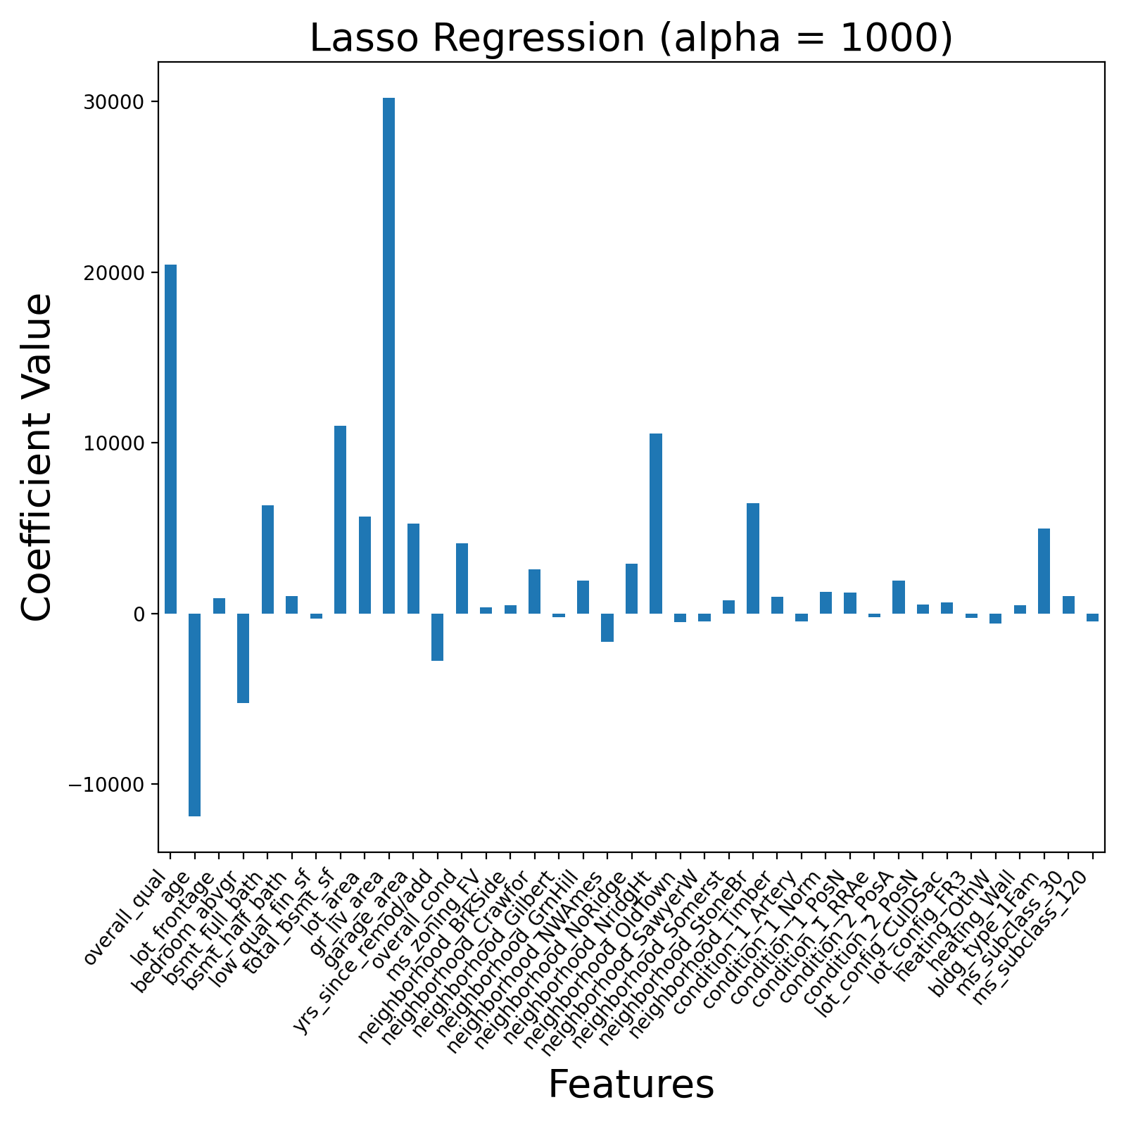
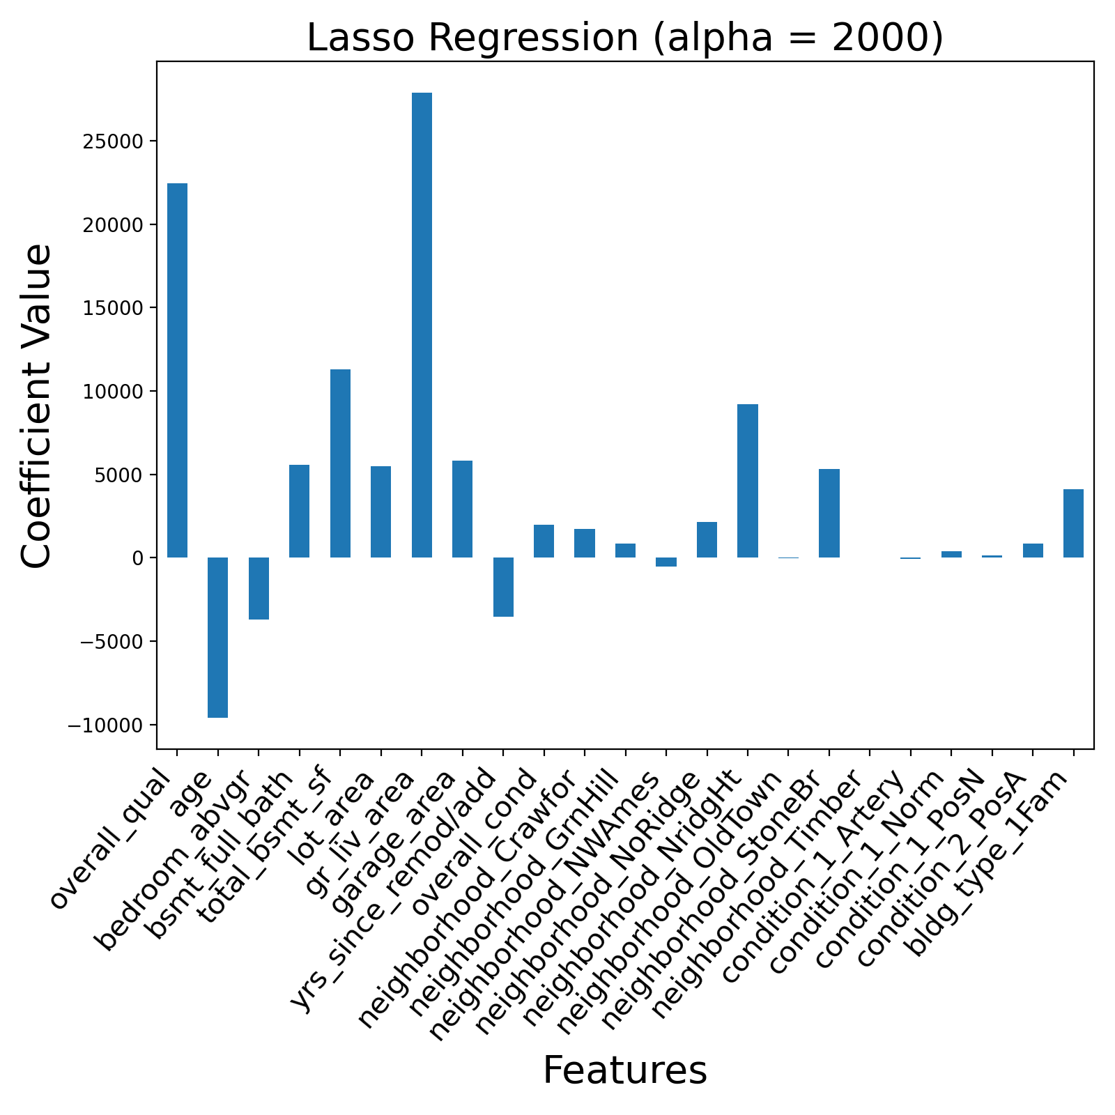
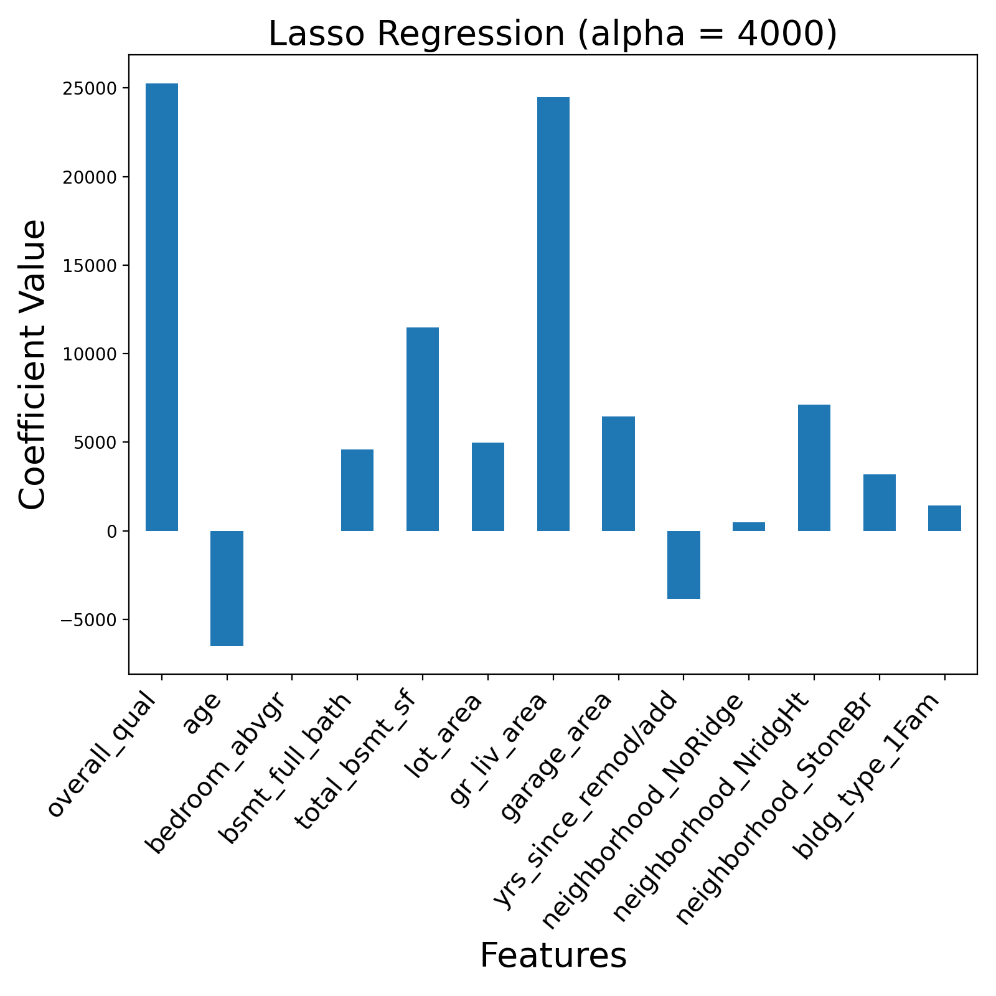
Feature Selection through Lasso Regression
Notes:
Bedrooms above grade very small at -6
Bedrooms above grade, age, and years since remodelling all negative

Slide 8
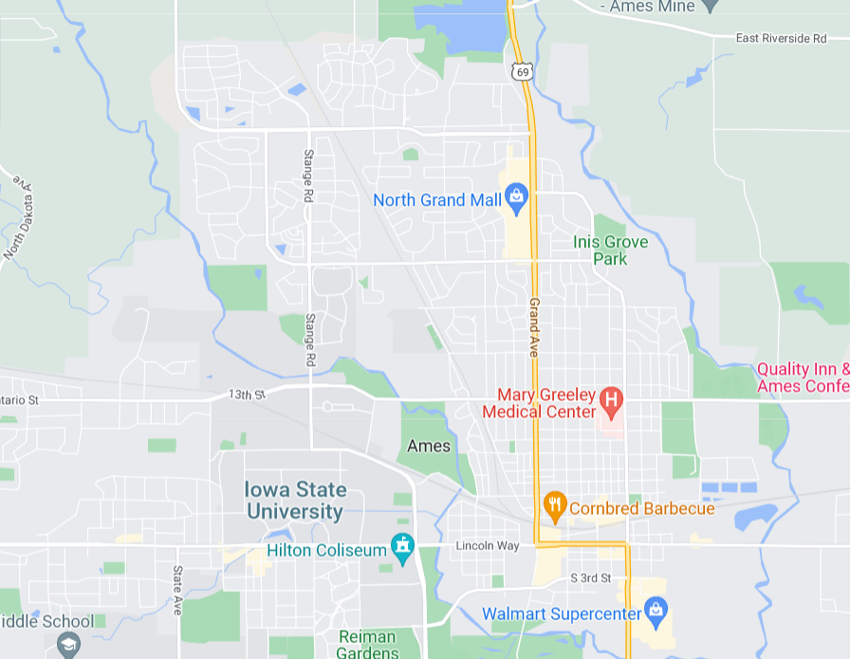
Insights
Bedroom above grade negative coefficient
Overall quality better predictor than location
Only three neighborhoods have a particularly strong
effect on price
A lot of the predictors are about area
Proximity to train stations or main roads not as big an influence as size
Notes:
Mean sale price increases as number of bedroom increases but peaks at 4 bedrooms
Even though number of bedrooms has a positive correlation with price, it has a negative coefficient when taking other predictors into account
Implies that it is not really number of bedrooms that has an increase in sale price per se, but what a large number of bedrooms implies i.e. bigger living area
Quality stronger predictor than location and even living area; Location only 4th strongest predictor at best
Other dummy neighborhoods dropped off. Since these three have positive coefficients, they must be the more desirable neighborhoods in Ames
6 out of the 11 variables here are related to size; at the end of the day, size is king

Slide 9
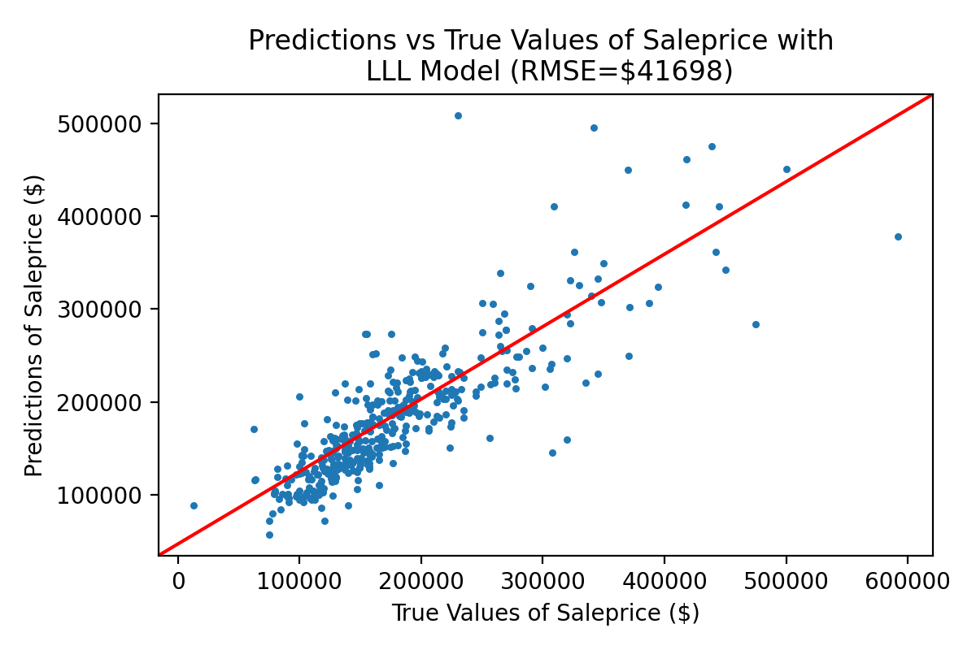
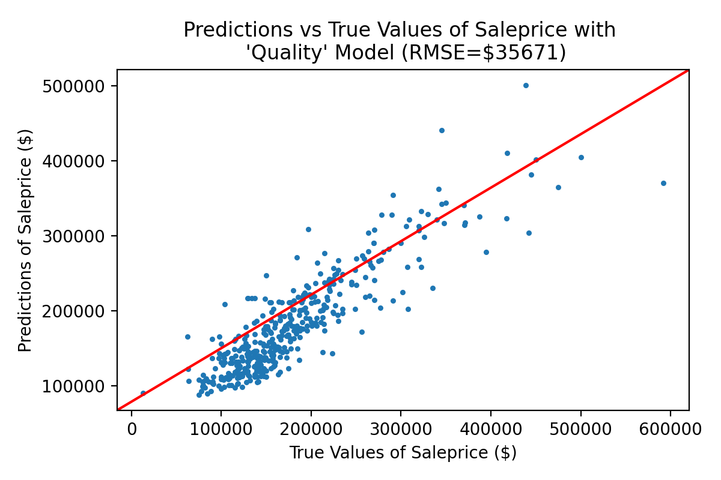
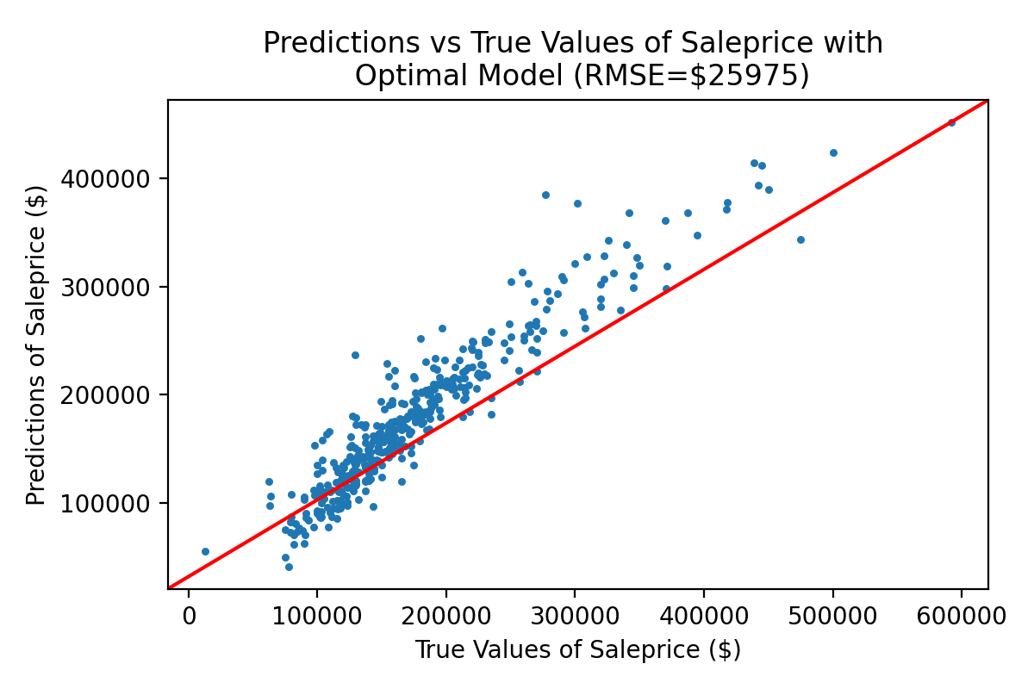
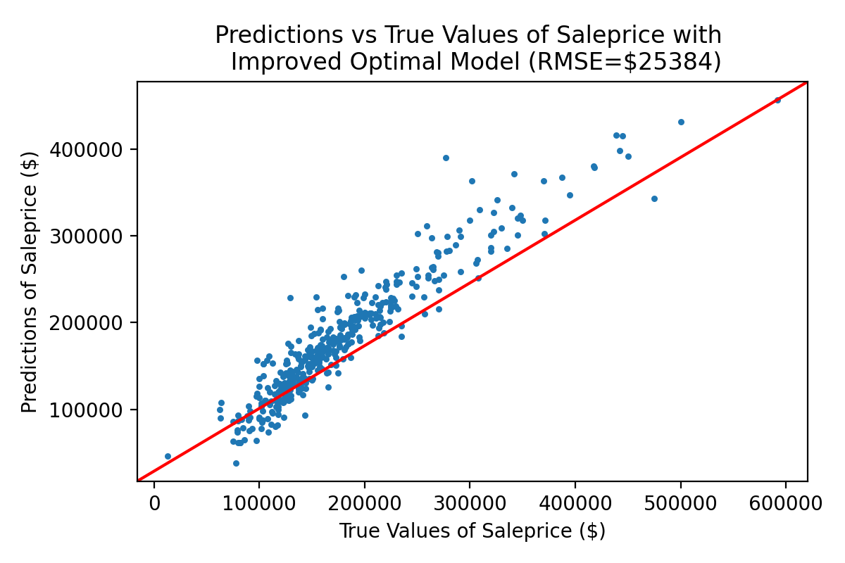
Results
1) overall_qual
2) age
3) bedroom_abvgr
4) bsmt_full_bath
5) total_bsmt_sf
6) lot_area
7) gr_liv_area
8) garage_area
9) yrs_since_remod/add
10) neighborhood
11) bldg_type
bsmt_half_bath
full_bath
half_bath
lot_frontage
overall_cond
ms_subclass
central_air
heating
utilities
Notes:
Based on the clusters of data points, Can see that location is better at predicting houses of lower values than the material quality of the house, but material quality is better at predicting houses of higher values
Quality tends to underestimate the value of the house
Our optimal model that uses all 11 of our features shown in our feature-selecting lasso regression = 4000 gives us a more accurate model
Improved optimal model that includes the next 9 strongest features as per our feature-selecting lasso regressions

Slide 10
Conclusion and Recommendations
Location is not the second-most important predictor
Results only hold for Ames
LLL’s mode may be more effective when applied to other, more dense cities
Notes:
Next time, instead of using external research to select features, use it just as reference as to which features to look out so as to not skip important features
Tradeoff of speed versus accuracy. Low bias but higher variance

Slide 11
Questions and Answers

